Slide 1

Customer Churn Prediction
Batch No: A-09 Project Guide:
G.Lavanya (164G1A0548) M.Soumya, M.Tech.
S.Bhargavi (164G1A0514) Assistant Professor`
S.Ayesha (164G1A0508)
B.Kranthi Kumar (164G1A0541)
Srinivasa Ramanujan Institute of Technology
Department of Computer Science & Engineering

Slide 2
Introduction
In the present world, a huge volume of data is being generated by telecom companies at an exceedingly fast rate. There is a range of telecom service providers competing in the market to increase their client share. Customers have multiple options in the form of better and less expensive services. The ultimate goal of telecom companies is to maximize their profit and stay alive in a competitive market place. A customer churn happens when a vast percentage of clients are not satisfied.

Slide 3
Abstract
Churn Analysis is one of the world wide used analysis on Subscription Oriented Industries to analyze customer behaviors to predict the customers which are about to leave the service agreement from a company.
It is based on Machine Learning methods and algorithms and become so important for companies in today’s commercial conditions as gaining a new customer’s cost is more than retaining the existing ones.
There are many reasons for churning. Unlike postpaid customers, prepaid customers are not bound to a service provider and may churn at any time.

Slide 4
Problem Statement
Analysis of Machine Learning Techniques for Churn Prediction and Factor Identification in Telecom Sector

Slide 5
Existing System
The decision trees are the most commonly recognized methods used for prediction of problems associated with the customer churn.
Disadvantages:
1. Decision trees are prone to overfitting
2. For a Decision tree sometimes calculation can go far more
complex compared to other algorithms.
3.Decision trees often involve higher time to train the model.

Slide 6
Proposed System
Proposes a churn prediction model that uses classiﬁcation,as well as,clustering techniques to identify the churn customers and provides the factors behind the churning of customers in the telecom sector.
After classiﬁcation, the proposed model segments the churning customer’s data by categorizing the churn customers in groups using k-means algorithm to provide group-based retention offers.

Slide 7
Algorithms
Here a supervised machine learning method has been proposed for customer churn analysis. Few algorithms that are applied are:
Logistic Regression
Random forest Classifier
Support Vector Machine
K nearest neighbor
Gradient Boost
Adaboost
XGBoost
LightGBM

Slide 8
Data Flow Diagram
Dataset
Data
Preprocesing
Data Selection
Non churn
Classification
Churn
Clustering

Slide 9
Implementation
1. Loading the Dataset
2. Data Preprocessing
3. Feature Selection
a) Correlation
b) Information Gain
4. Customer Classification and Prediction
a) Applying Machine Learning Techniques
b) Churn /Non churn
5. Factor Identification
6. Clustering

Slide 10
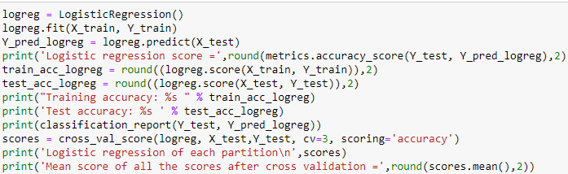
Implementation
code for Model building using logistic regression

Slide 11
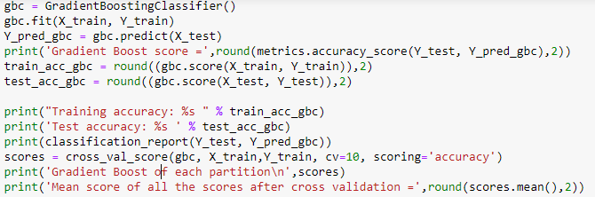
Model building using gradient boosting algorithm

Slide 12
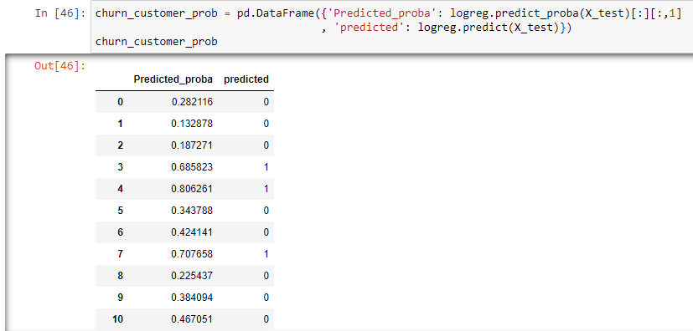
Classification Output

Slide 13
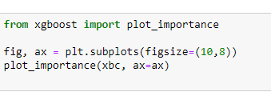
Factor identification:

Slide 14
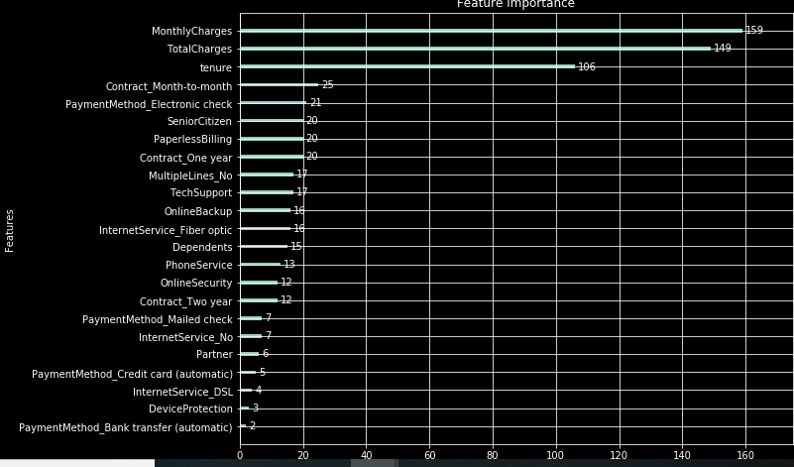
Factor Identification

Slide 15
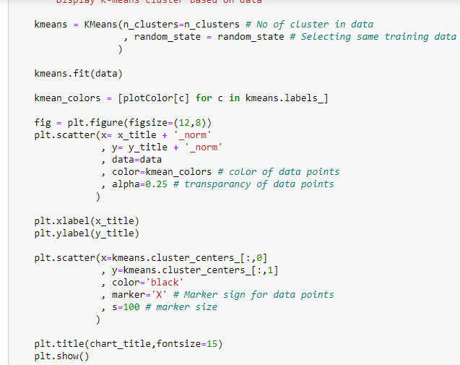
Clustering

Slide 16
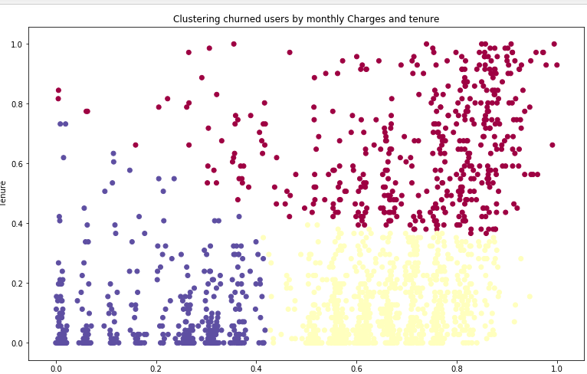
Output

Slide 17
Requirements
Hardware and Software Requirements
S/W System Requirements :
Operating System : Windows 7/8/10
Python IDLE
Anaconda-Jupyter Notebook
Hardware Requirements :
Processor - Intel i3
RAM - 4GB
Hard Disk - 500 GB

Slide 18
Literature Survey
N.Kamalraj and A.Malathi proposed “A Survey on Churn Prediction Techniques in Communication Sector”.
Ina Maryani1 and Dwiza Riana2 propsed “Clustering and Profiling of Customers Using RFM For Customer Relationship Management Recommendations”.

